Slide 1

English presentation
The X-factory, by Soraya Timmers

Slide 2

The index
The project
The X-factory
The weapon scène
The concept
The product
Business plan
Logo
3D models
The scène
The process
Questions

Slide 3

The Project
The X-factory
NG-ON
Purpose:
increase the drive to achieve achievements in games
The weapon scène
Weapon
Purpose:
To increase the drive to achieve achievements in games
The concept
Hope & Despair
Mushrooms
The style guide:
Visual references and sketches

Slide 4


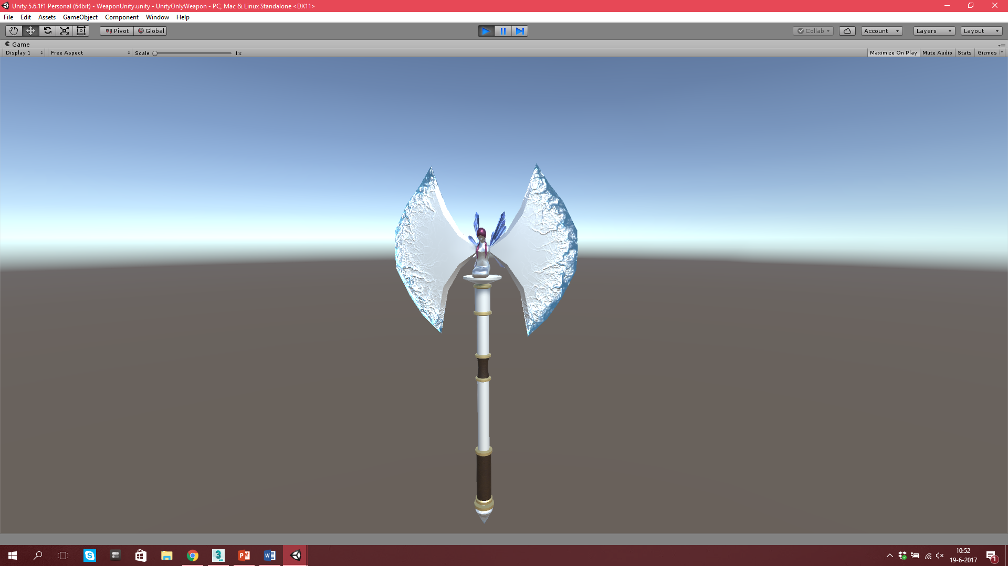
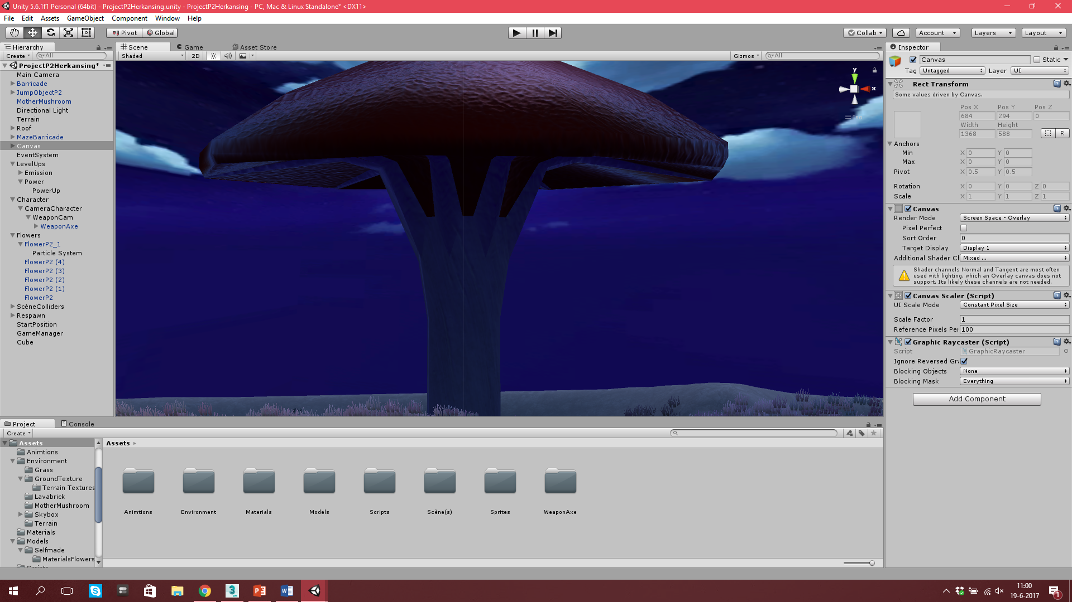
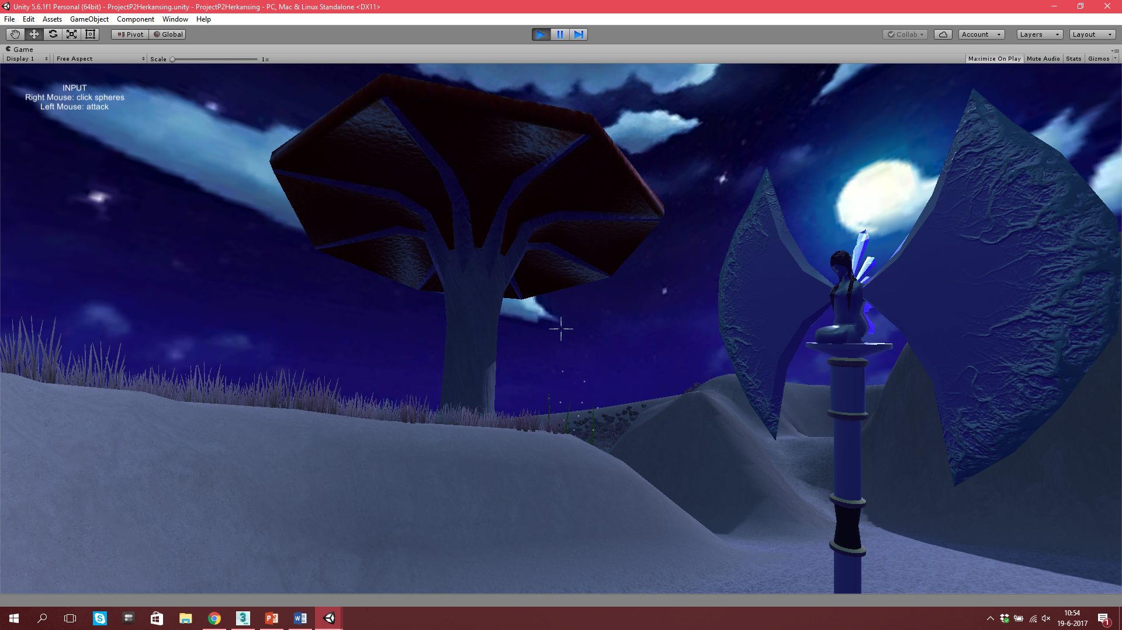
The product
The business plan
Mission and vision
Target audience
Products
Core values
Division of tasks
Logo

Slide 5
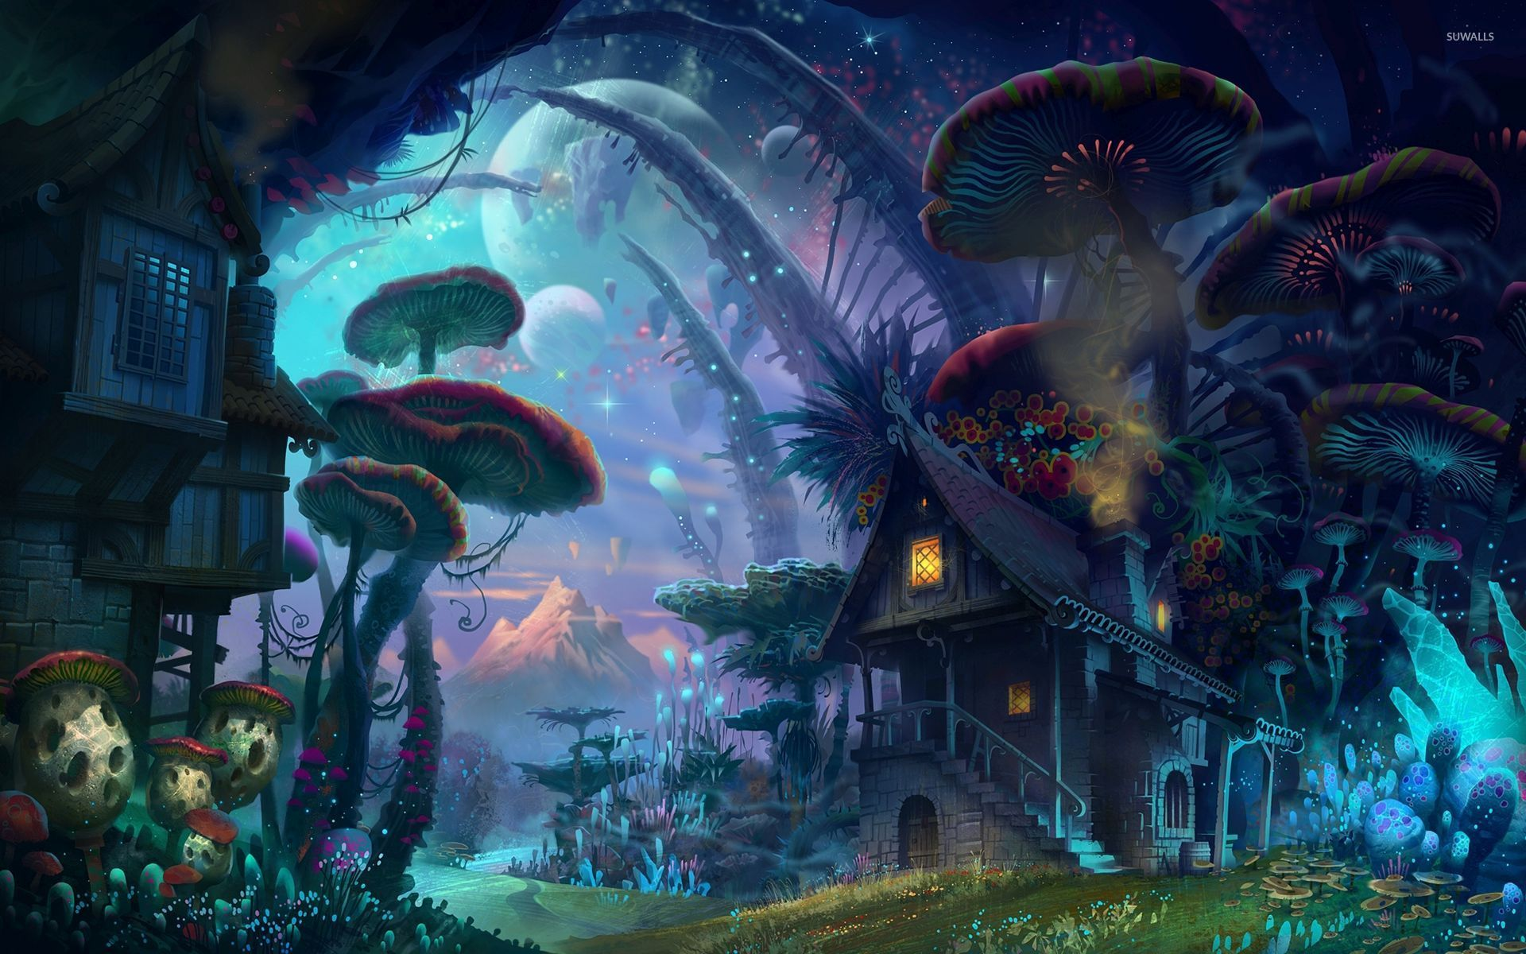
The proces
Rough
Good collaboration
Bad results

Slide 6
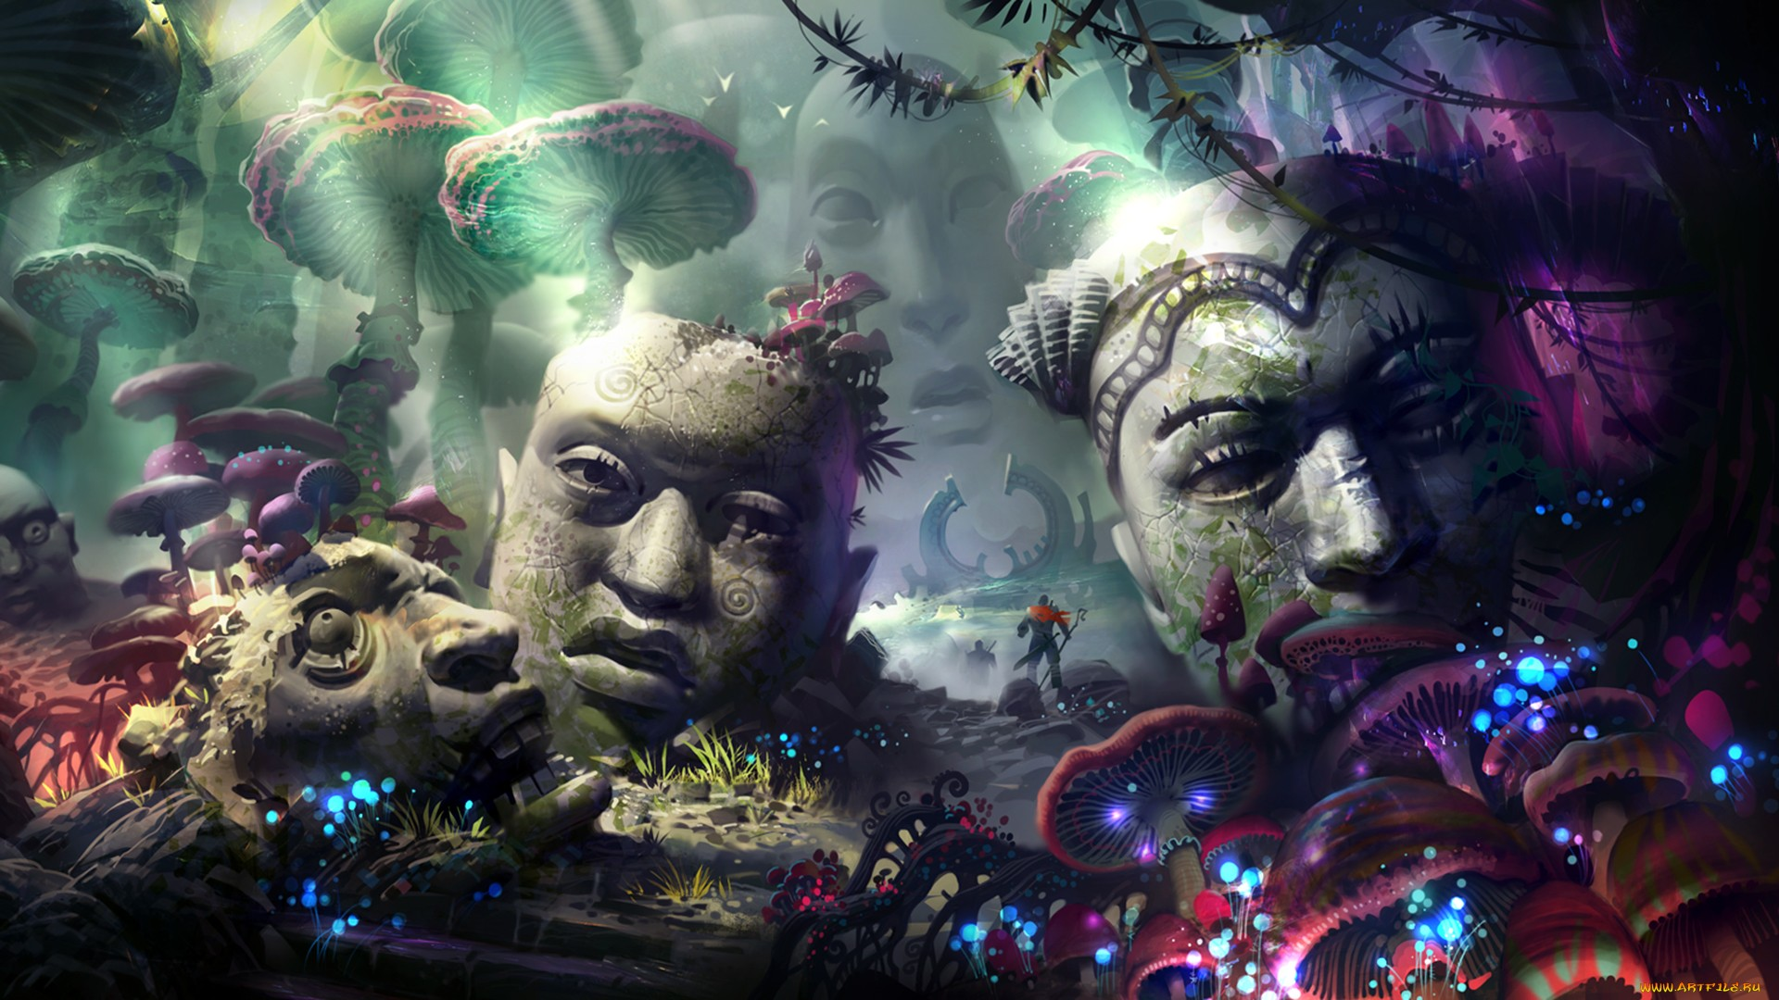
Questions

